Slide 1
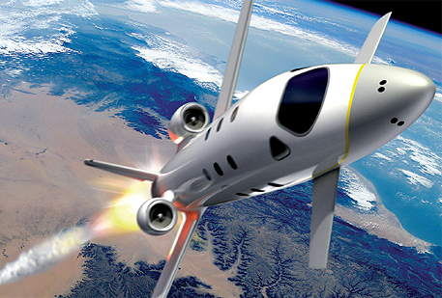

FDIR Spacecraft fault protection system
Project 1
Part 2
Euro Team
Alauzet Pierre, Ahvenniemi Mikko,
Colin Julien, Starck Benoit
CS554 - Design for Software & Systems

Slide 2
Table of ContentS
Domains identification
Requirements
Context diagram
Problem diagram
Problem frames

Slide 3
Domains identification
Spacecraft
Crew
Information display
Ground control
Spare system
Anthena

Slide 4
Crew
Ground Control
Systems
FDIR
Antenna
Report
Information Display
FDIR Storage System

Slide 5
requirements
Displaying information continuously
Display pattern
Information retrieval
Part of behavior commanded pattern
Manual control of FDIR
Crew is able to shutdown part of the system
Crew is able to restart part of the system
Crew is able to switch to a spare system
Providing failure localization
Input/output
Automatic recovery to failure

Slide 6
Collect system data to data storage
Response in case of unresolvable failure
Response in case of hazardous conditions
Men spacecraft
Unmanned spacecraft

Slide 7
Displaying information continuously
Information display
C
a
d
FDIR
Display information
c
b
Systems
C
c: Systems! {send value/no value}
b: Systems!{functionnal/not funct. proper./broken}
d: FDIR! {display in tol/out-of-tol/no resp}
a: Information display!{console}
Display problem frame

Slide 8
Displaying information continuously (cont.)
FDIR should display continuous information about state of the systems
FDIR has to interprate monitored values from each space craft system
Return it into a standard message displayed on the FDIR console
Considering received message, the FDIR or the crew should be able to understand what was the current state of the systems

Slide 9
Information retrieval
FDIR Storage System
C
a
c
FDIR
Retrieve information
b
Crew/ Ground Control
d
B
c:FDIR! {query}
FDIR Subs!{return data}
a: FDIR Subs!{status data}
b:Crew!{search}
FDIR!{display}
d: Crew!{search}
Commanded behaviour problem frame

Slide 10
Information retrieval
FDIR executes query, and the FDIR Subsystems reply
The crew or ground control can search data, and the FDIR displays its

Slide 11
Manual control of FDIR
Systems
C
a
d
Control command
FDIR
c
b
Crew / Ground Control
B
c:CGC! {Do shutdown,Do restart,Do switch to backup}
FDIR!{return command status}
b: {Shutdown, Restart, Switch to backup}
d:FDIR! {Issue Shutdown,Issue Restart, Issue Switch}
a: {Operational}
Commanded behaviour problem frame

Slide 12
Manual control of FDIR
FDIR has to provide interface for issuing manual commands from the crew or ground control at anytime
FDIR is able to send commands (shutdown,restart,switch to a different backup) to the spacecraft›s several systems
The systems has to remain available and responding while processing commands
FDIR must be able to multitask commands

Slide 13
Providing failure localization
FDIR Storage System
C
a
d
FDIR
Locate system failure
c
b
Report
C
c:FDIR! {failure location,type of failure}
b:Report! {failure data}
d:FDIR Storage System! {device, value}
a:FDIR Storage System!{device, value, time}
Transformation problem frame

Slide 14
Providing failure localization(cont.)
The FDIR Storage System contains the collected values or data from devices
FDIR checks the inputs from the storage system, and analyses these inputs to determine failure location.
Failure location is written into a report.

Slide 15
Collect systems data to data storage
Systems
C
a
d
Data Transfer
FDIR
c
b
FDIR Storage
System
C
c: FDIR! {System ID, state value, time}
b: {System data}
d: Systems! {value, no value}
a: Systems! {System ID, state}
Display problem frame

Slide 16
Collect systems data to data storage(cont.)
State values are collected from the systems at regular intervals
The FDRI receives the data and stores it with a timestamp to the FDRI Storage System for further use
When data storage is centralized it doesn't matter if some systems go down, because data analysis can still be done on the stored data.

Slide 17
C
a
d
FDIR
c
b
C
c:! {}
b: {}
d:! {}
a: {}
Display problem frame

Slide 18
(cont.)

Slide 19
FDIR Spacecraft fault protection system
Project 1
Part 2
Euro Team
Alauzet Pierre, Ahvenniemi Mikko,
Colin Julien, Starck Benoit
CS554 - Design for Software & Systems

Slide 20
references
[Eas98] Steve Easterbrook, and et al., “Experiences Using Lightweight Formal Methods for Requirements Modeling,” IEEE Transactions on Software Engineering, Vol. 24, No. 1, January 1998.

